Slide 1
Predicting Passenger Survival - Titanic Dataset
Bilal Ullah

Slide 2

Use Case
I have been approached by the National Transportation Safety Board (NTSB) to investigate data of crashes of large vehicles
The aim for the NTSB is to investigate whether or not the survival of a passenger can be predicted and if so what does this depend on
In particular I have been tasked with the titanic dataset and have to predict the survival of passengers

Slide 3
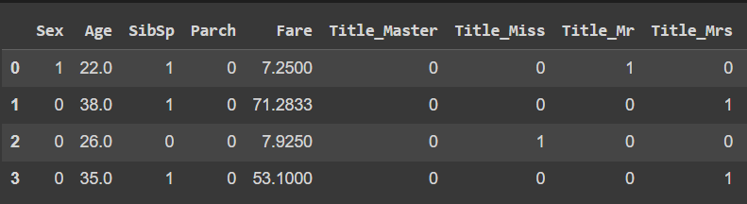
Preview of data
Size of data:
891 rows
69 features
All Numeric data
Passenger profile
Ticket location
Cabin type

Slide 4
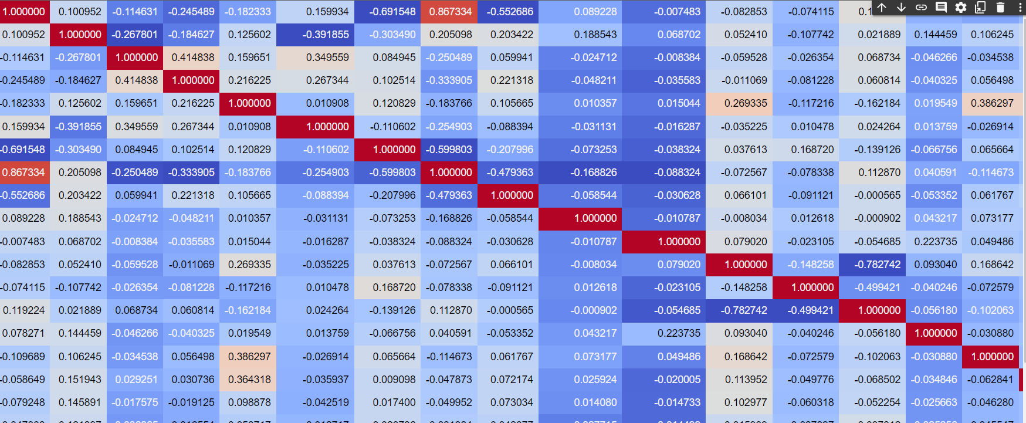
Feature selection
69 features to select from
Features needed to be reduced significantly to optimize time and model results
As there are so many features it is not efficient to manually pick features

Slide 5

Feature Selection
ANOVA
We want to determine whether a set of means are all equal.
To evaluate this with an F-test, we need to use the proper variances in the ratio.
Most Significant:
Ticket_XXX
Cabin_T
Corr plot
Features selected from the correlation included any correlation that was outside the ranges of -0.02 - 0.02

Slide 6
Standardization
This was carried out on the continuous variables remaining
Scaling data to fit a standard normal distribution. A standard normal distribution is defined as a distribution with a mean of 0 and a standard deviation of 1.
This was carried out on these features:
'Age', 'Fare', 'Parch', 'SibSp', 'FamilySize'

Slide 7
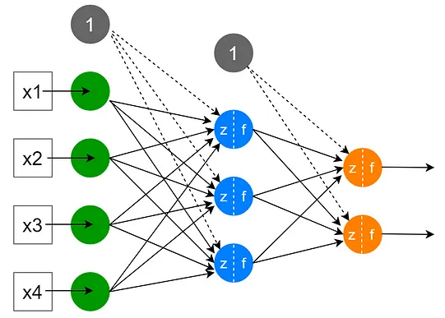
Shallow ANN
A shallow is a type of Neural Network with only one hidden layer
Input Node
Hidden layer
Output
Each node within the hidden layer consists of weights and activations
Activations play a crucial role in the Neural Networks

Slide 8
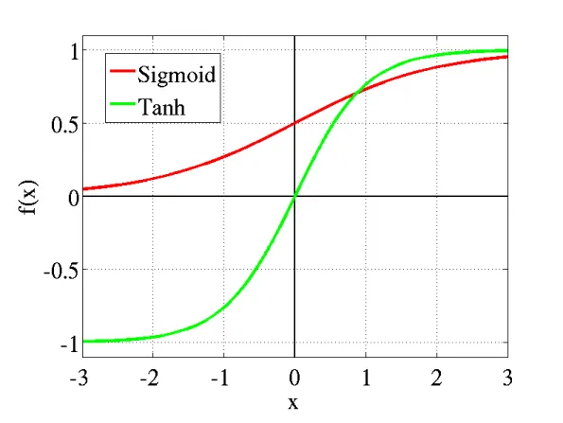
Activation Method
To introduce non-linearity in the network, activation functions are necessary
Sigmoid and Tanh are effective as it results in higher values of gradient during training and higher updates in the weights of the network.
As the output in this case is either survived or died, we want strong gradients and big learning steps.

Slide 9
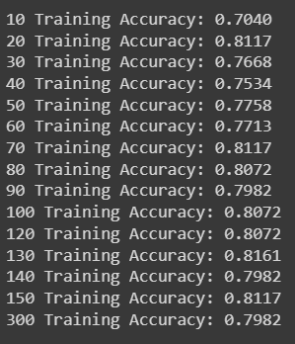
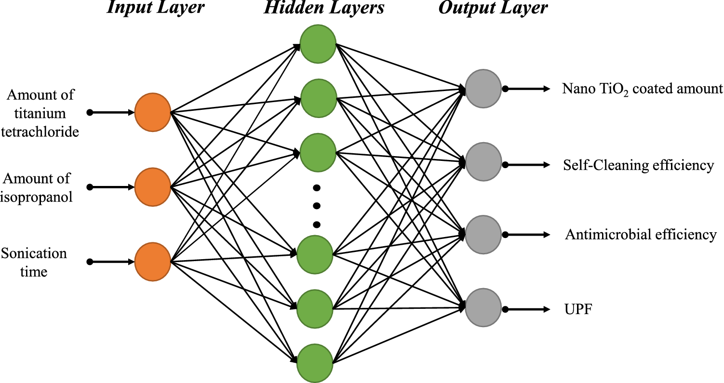
Optimization
No Packages!
Manual optimization
Quick test by increasing nodes in the neural network to see effect on results

Slide 10
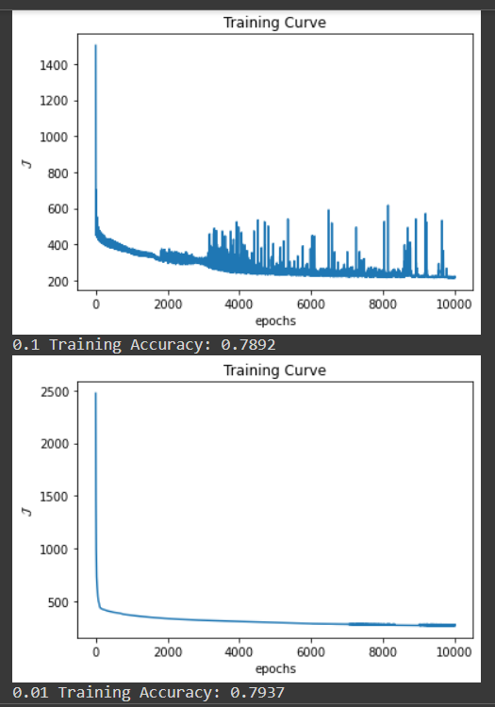
Optimization
Same method was carried out for learning rate
Oscillation occurred on many training curves which indicates dataset may be too small
Less than 900 rows

Slide 11
Results
Nodes | eta | epochs | Accuracy
30 | 1e-2 | 1e4 | 79.51%
50 | 1e-3 | 1e5 | 80.74%
70 | 1e-2 | 1e4 | 83.41%
150 | 1e-2 | 1e5 | 81.17%
Evaluation for best parameters
Precision | Recall | F1 | Accuracy
76.47 | 79.27 | 77.84 | 83.41

Slide 12

Summary
Key Points
Feature Selection
Standardization
Activation method
Optimization
Results
Positive results
Use case effectiveness:
The NTSB can take confidence in these results and build on this model to further aid their analysis in future investigations

Slide 13
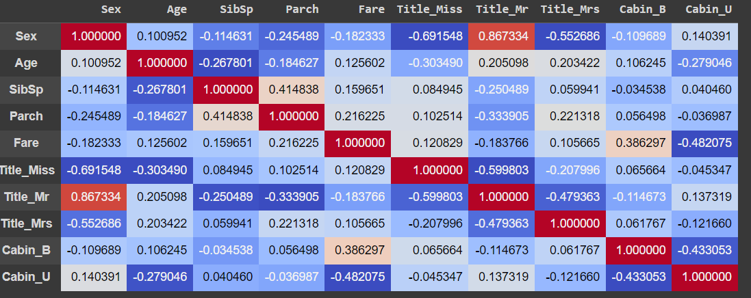
Appendix

Slide 14
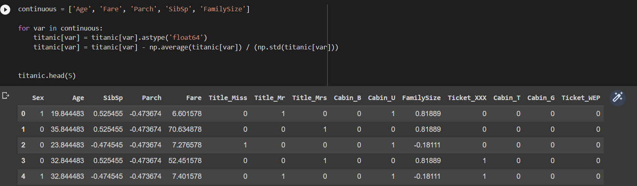
Standardized

